Slide 1
Smart Watch Price Prediction
PROJECT
Presented By:
Gaddam Raghu Varma
Chalapathi Institute of Engineering & Technology
Computer science and Engineering

Slide 2
OUTLINE
Problem Statement
Proposed System/Solution
System Development Approach (Technology Used)
Algorithm & Deployment
Result
Conclusion
Future Scope
References

Slide 3
Problem Statement
Smartwatch price prediction is a challenging task due to the rapid evolution of smartwatch technology and the diverse range of models available in the market. However, by using machine learning techniques, it is possible to develop models that can predict smartwatch prices with reasonable accuracy.
In The Ever-evolving market of consumer electronics, specifically within the realm of smartwatches, consumers and retailers face a critical challenge: the lack of an efficient and accurate means to predict the prices of smartwatches.

Slide 4
Proposed Solution
The proposed system aims to address the challenge of predicting the required bike count at each hour to ensure a stable supply of rental bikes. This involves leveraging data analytics and machine learning techniques to forecast demand patterns accurately. The solution will consist of the following components:
Data Collection:
Gather historical data on bike rentals, including time, date, location, and other relevant factors.
Utilize real-time data sources, such as weather conditions, events, and holidays, to enhance prediction accuracy.
Data Preprocessing:
Clean and preprocess the collected data to handle missing values, outliers, and inconsistencies.
Feature engineering to extract relevant features from the data that might impact bike demand.
Machine Learning Algorithm:
Implement a machine learning algorithm, such as a time-series forecasting model (e.g., ARIMA, SARIMA, or LSTM), to predict bike counts based on historical patterns.
Consider incorporating other factors like weather conditions, day of the week, and special events to improve prediction accuracy.
Deployment:
Develop a user-friendly interface or application that provides real-time predictions for bike counts at different hours.
Deploy the solution on a scalable and reliable platform, considering factors like server infrastructure, response time, and user accessibility.
Evaluation:
Assess the model's performance using appropriate metrics such as Mean Absolute Error (MAE), Root Mean Squared Error (RMSE), or other relevant metrics.
Fine-tune the model based on feedback and continuous monitoring of prediction accuracy.
Result:

Slide 5
DESCRIPTION
Data Analytics is a process of scrutinizing the data to obtain accurate results. In data analytics the main purpose is extracting the original data from data. In this data analytics we need to perform the major that is data munging.
DATA MUNGING
It is a process of transferring unstructured data into structured format. The goal is to make the data more usable and valuable for analytics or other purposes.

Slide 6
System Approach
The "System Approach" section outlines the overall strategy and methodology for developing and implementing the rental bike prediction system. Here's a suggested structure for this section:
System requirements
➢ Basic Search Engine (Google)
➢ Google Colaboratory
➢ Graphical representation of Datasets
Library required to build the model
➢ Good latency internet access

Slide 7
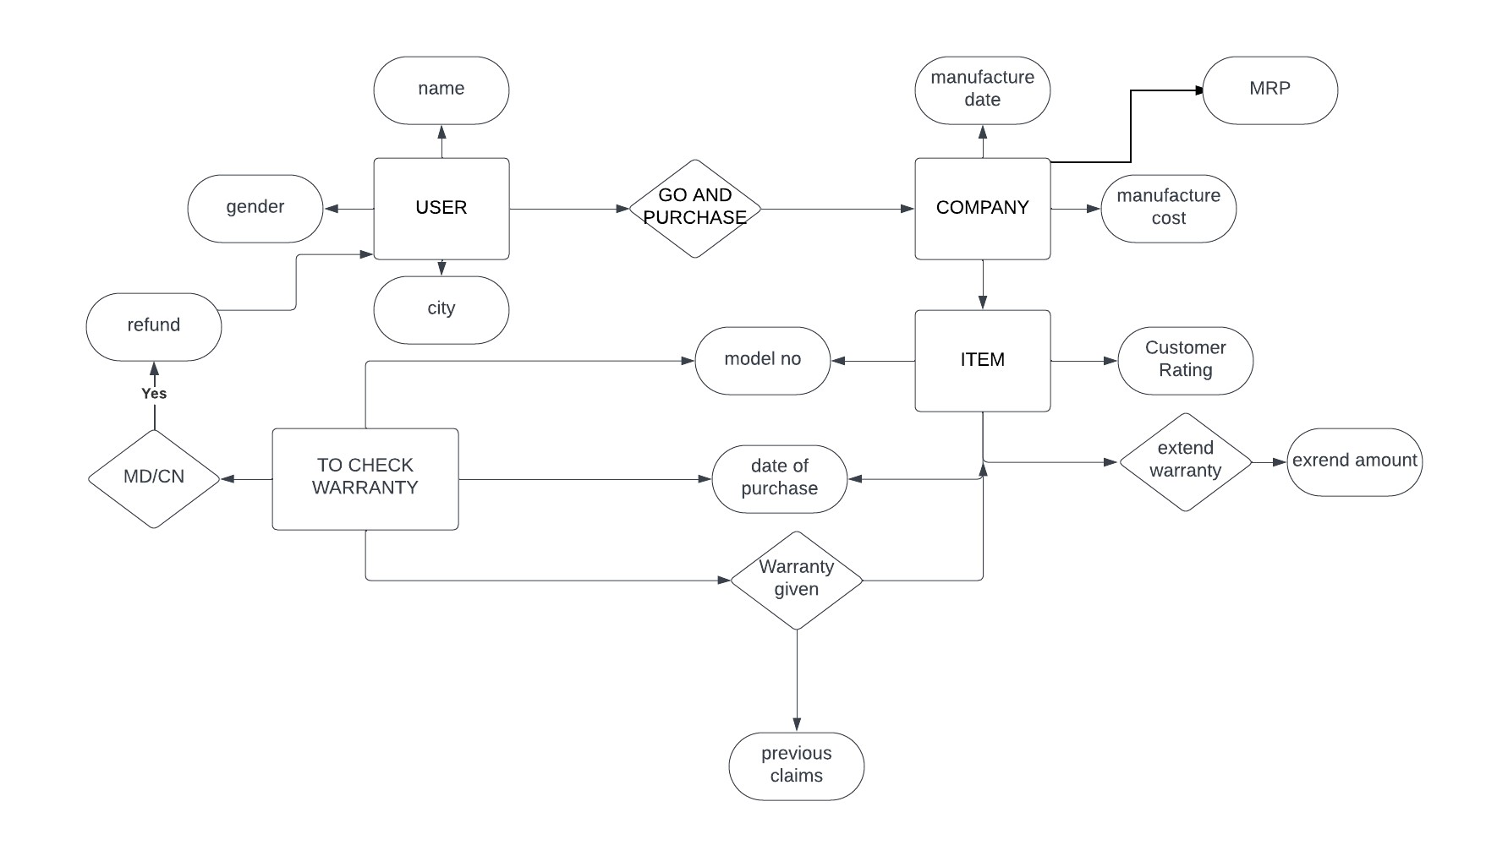
E-R DIAGRAM

Slide 8
Algorithm & Deployment
In the Algorithm section, describe the machine learning algorithm chosen for predicting bike counts. Here's an example structure for this section:
Algorithm Selection:
Provide a brief overview of the chosen algorithm (e.g., time-series forecasting model, like ARIMA or LSTM) and justify its selection based on the problem statement and data characteristics.
Data Input:
Specify the input features used by the algorithm, such as historical bike rental data, weather conditions, day of the week, and any other relevant factors.
Training Process:
Explain how the algorithm is trained using historical data. Highlight any specific considerations or techniques employed, such as cross-validation or hyperparameter tuning.
Prediction Process:
Detail how the trained algorithm makes predictions for future bike counts. Discuss any real-time data inputs considered during the prediction phase.

Slide 9
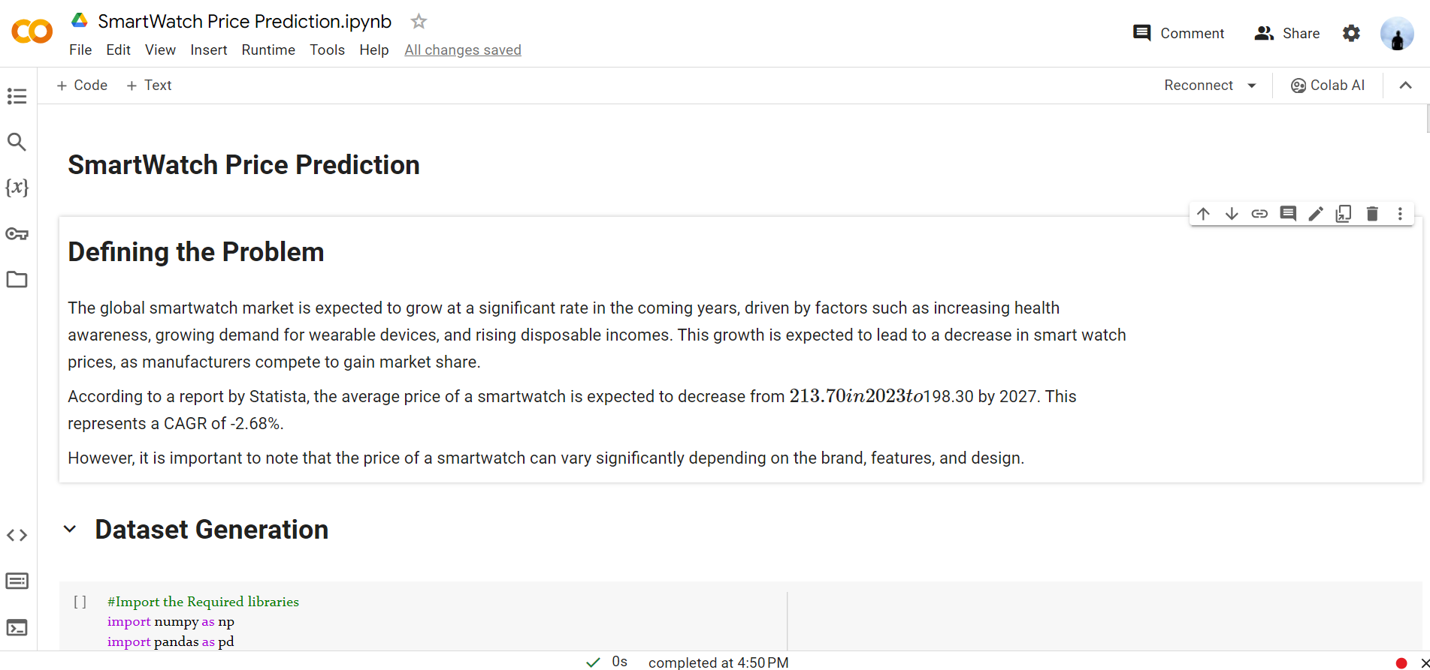

Slide 10
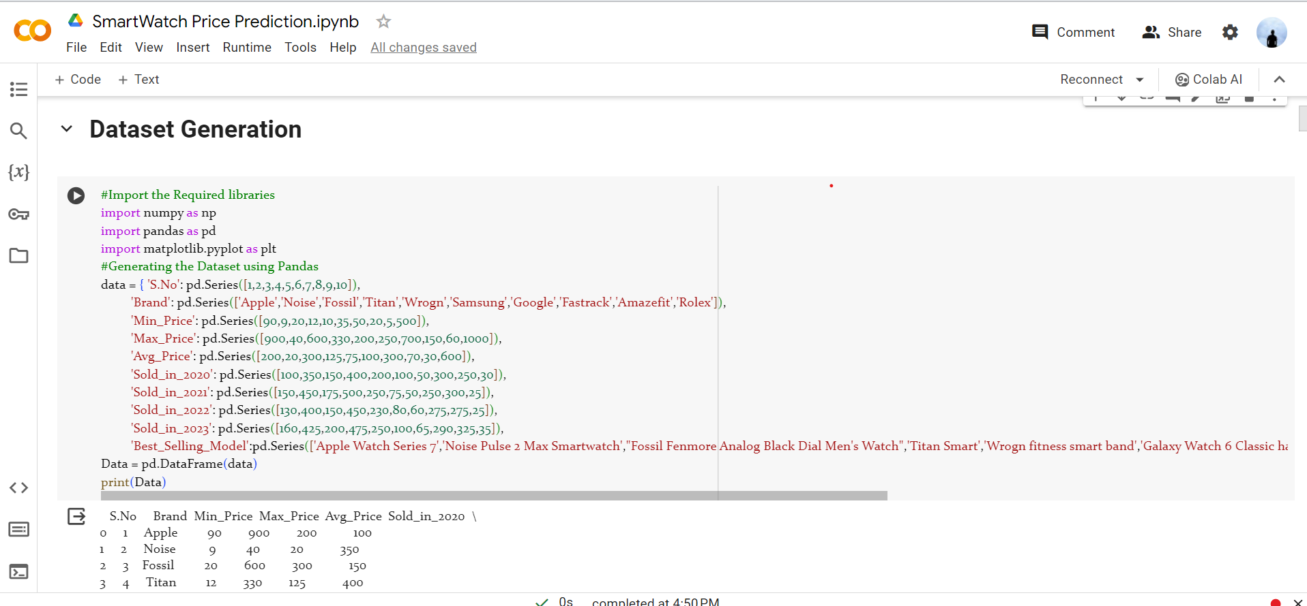

Slide 11
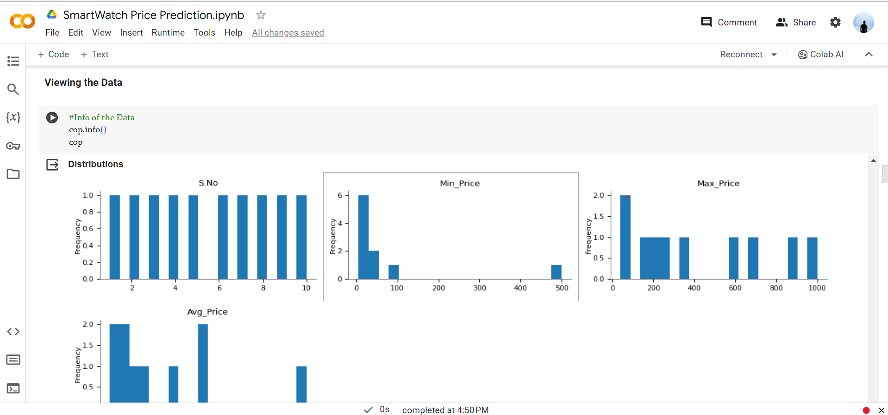

Slide 12
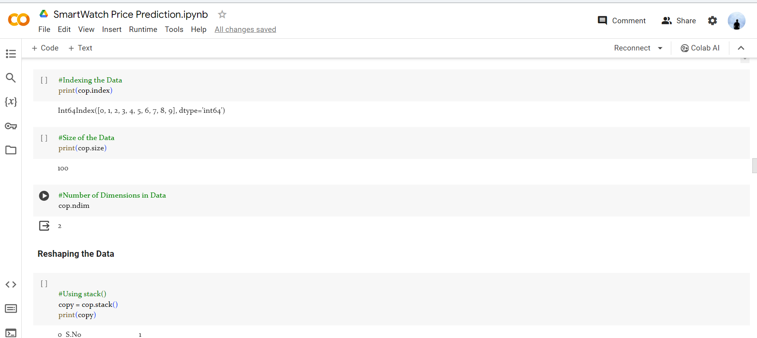

Slide 13
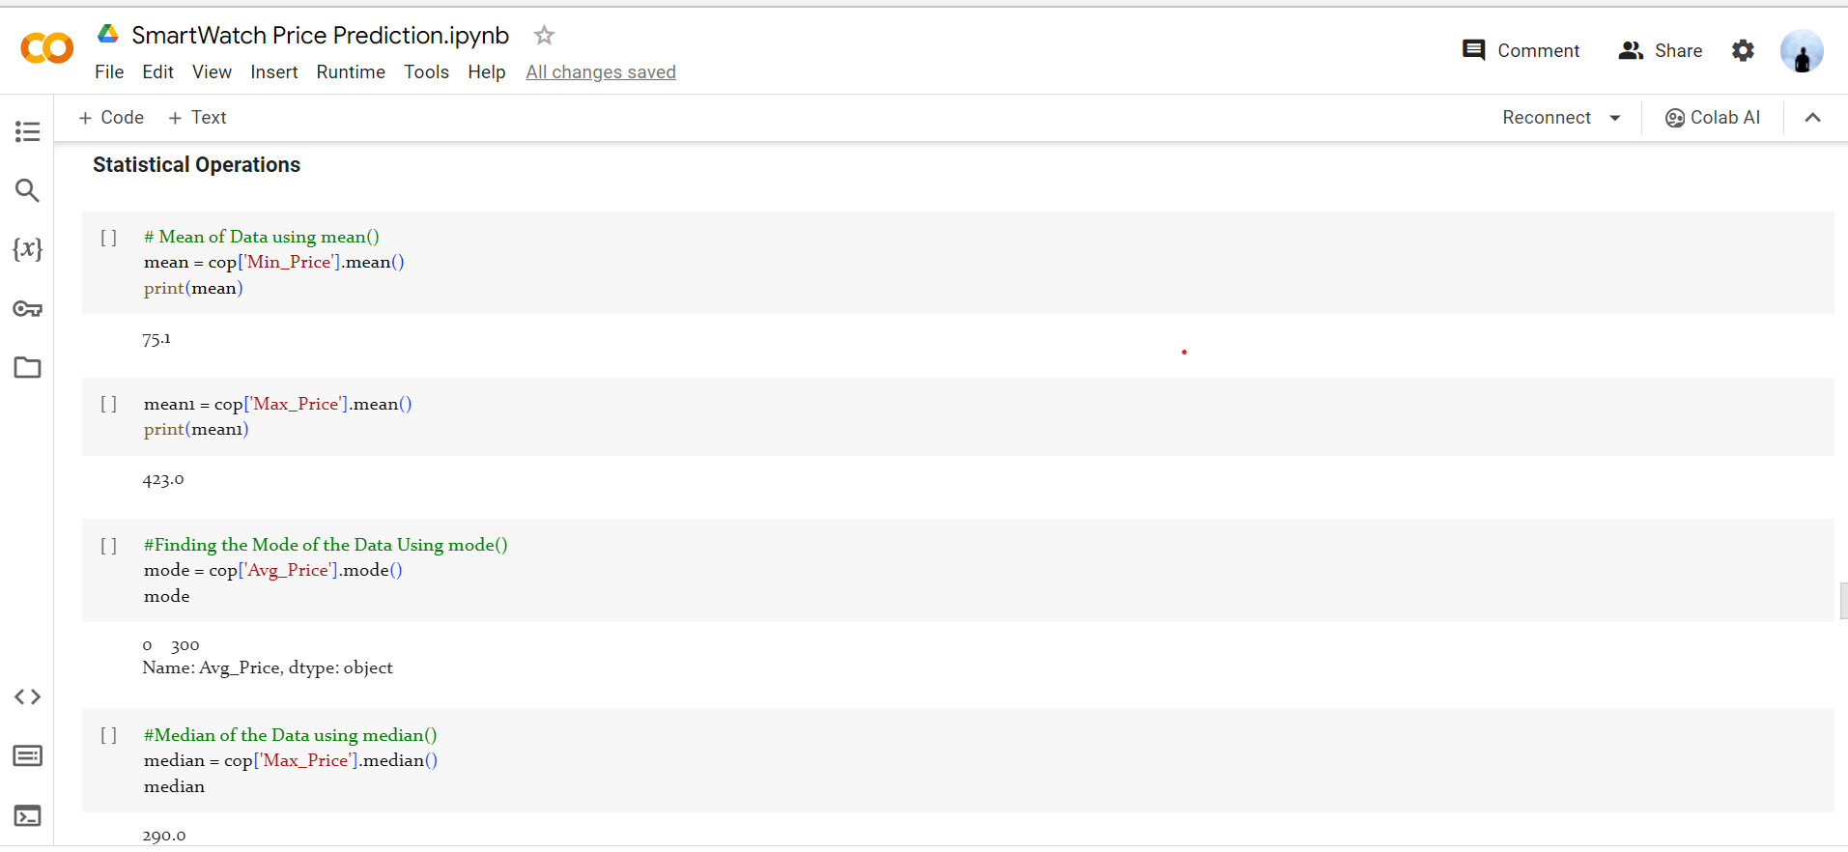

Slide 14
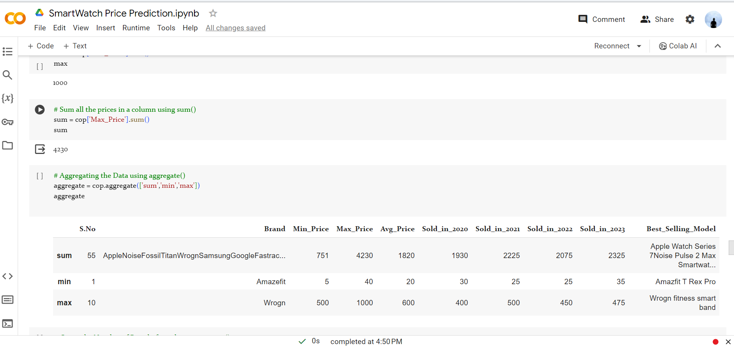

Slide 15
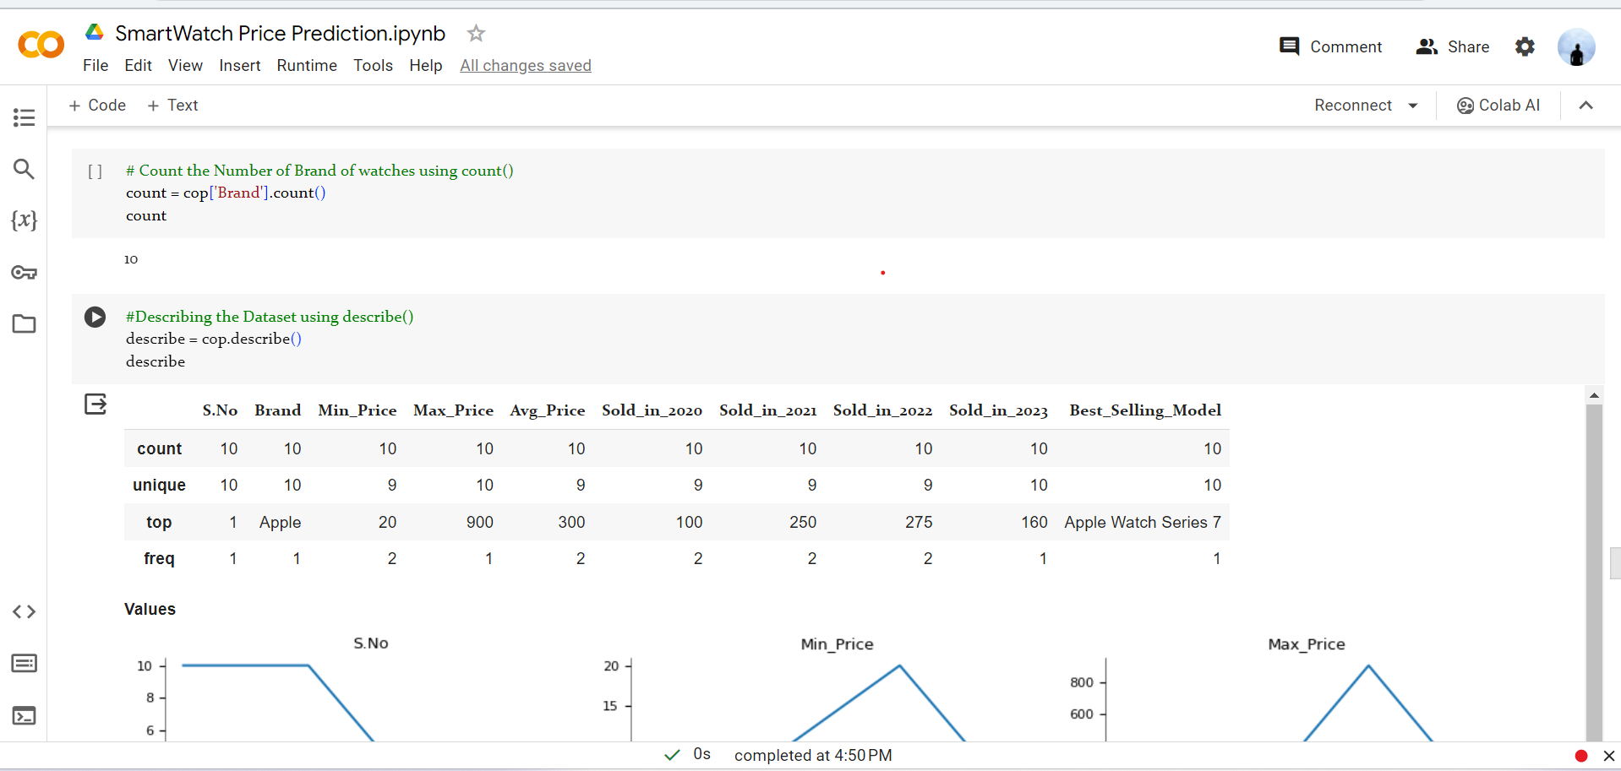

Slide 16
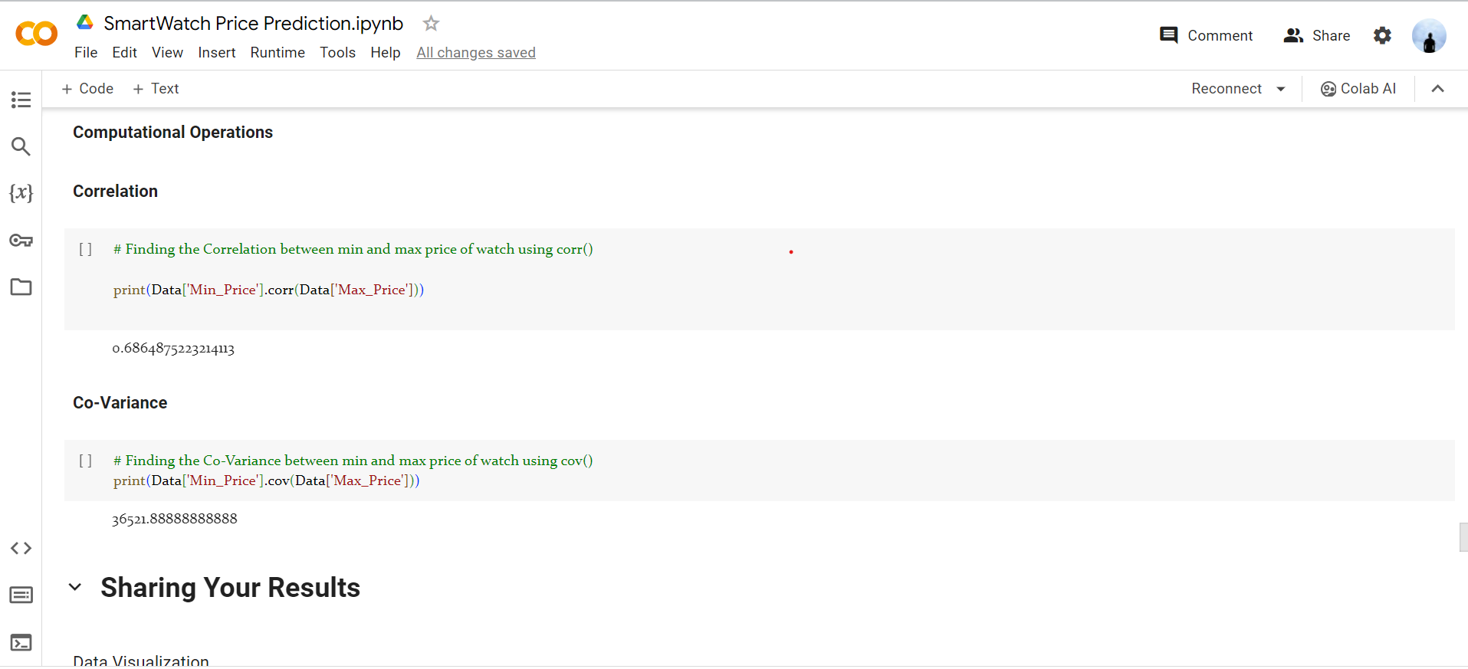

Slide 17
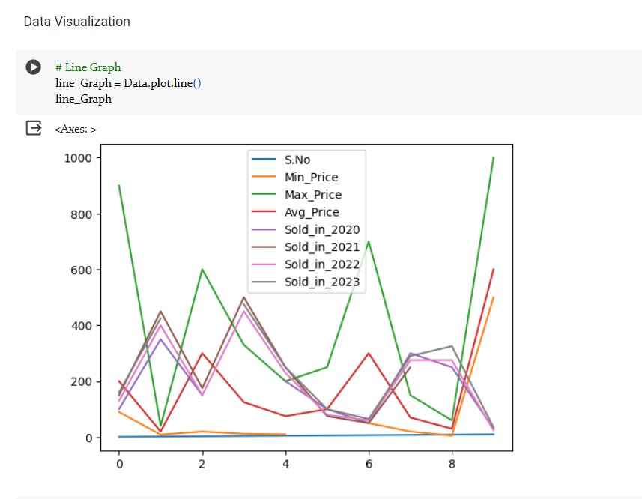

Slide 18
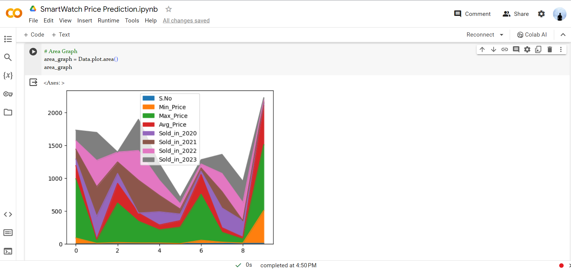

Slide 19
Result
What specific prediction results do you have? Numbers, graphs, visualizations, anything you can share would be helpful.
What model or method was used for the prediction? Knowing the approach can help understand the data and results.
What are your questions or what would you like to understand about the results? Do you want to know the predicted price range for a specific watch? Are you curious about the factors influencing the predictions?
.

Slide 20
Conclusion
What data points are plotted on the chart? (e.g., smartwatch features, prices)
What are the axes labeled?
Are there any lines or trends visible?
What specific questions do you have about the results?

Slide 21
Future scope
Brand and Model: Established brands like Apple and Samsung generally command higher prices compared to new entrants. Within brands, advanced models with more features are naturally more expensive.
Technical Specifications: Display size and resolution, battery life, processor, sensors (health-related features like ECG, SpO2, etc.), connectivity options (cellular, Wi-Fi, Bluetooth), and material used (sapphire glass, stainless steel) all impact price.
Market Demand and Competition: Popular models with high demand might see price fluctuations based on supply and demand dynamics. Competition between brands also drives price competitiveness.
Technological Advancements: New technologies and features being introduced can lead to price increases for the latest models, while older models might see price drops.
Economic Conditions: Overall economic stability and consumer

Slide 22
References
List and cite relevant sources, research papers, and articles that were instrumental in developing the proposed solution. This could include academic papers on bike demand prediction, machine learning algorithms, and best practices in data preprocessing and model evaluation.

Slide 23

course certificate 1

Slide 24

course certificate 2

Slide 25
THANK YOU

